Slide 1
Unsupervised and Deep Learning
Overview
Dec 2018
Joel Patterson
jpatter@us.ibm.com

Slide 2
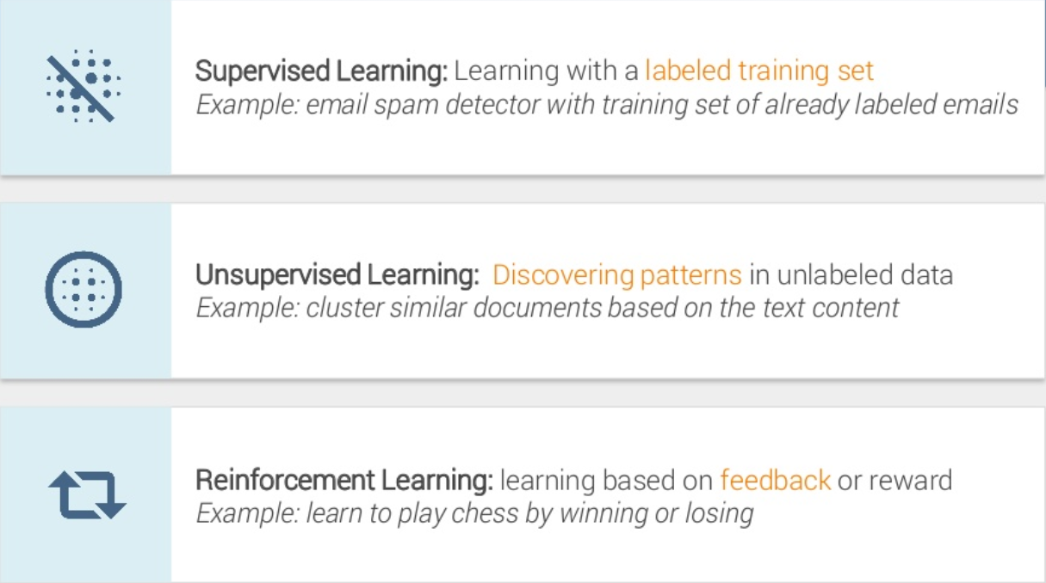
Machine Learning – Basics
Notes:
https://www.slideshare.net/LuMa921/deep-learning-a-visual-introduction?qid=8f03f985-8cac-48c6-b1d9-09f77d48a9cc&v=&b=&from_search=1

Slide 3
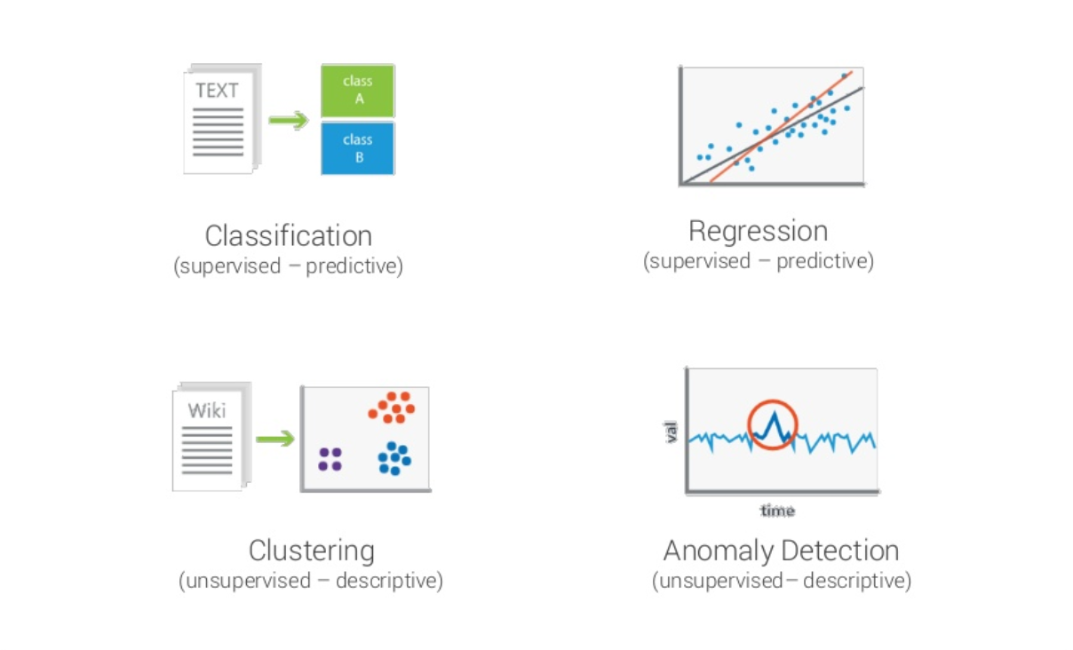
Machine Learning – Problem Types
Notes:
https://www.slideshare.net/LuMa921/deep-learning-a-visual-introduction?qid=8f03f985-8cac-48c6-b1d9-09f77d48a9cc&v=&b=&from_search=1

Slide 4
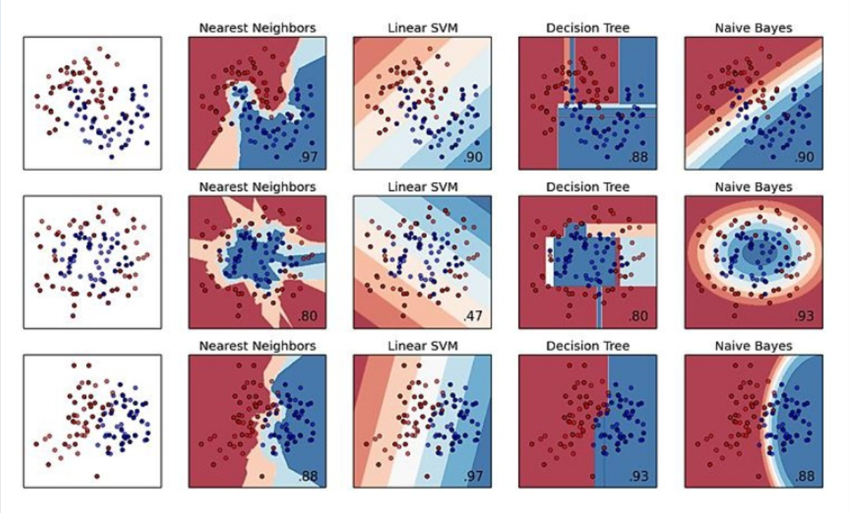
Algorithm Comparison - Classification
Notes:
https://www.slideshare.net/LuMa921/deep-learning-a-visual-introduction?qid=8f03f985-8cac-48c6-b1d9-09f77d48a9cc&v=&b=&from_search=1

Slide 5
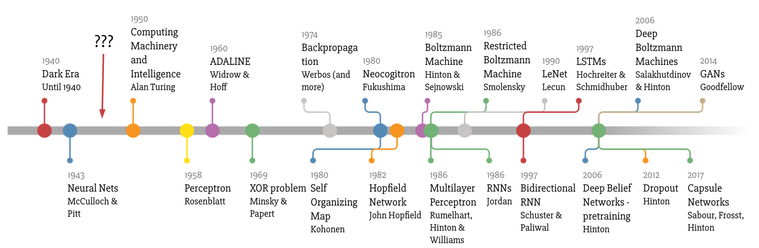
Deep Learning Timeline by Favio Vazquez
Notes:
https://towardsdatascience.com/a-weird-introduction-to-deep-learning-7828803693b0

Slide 6
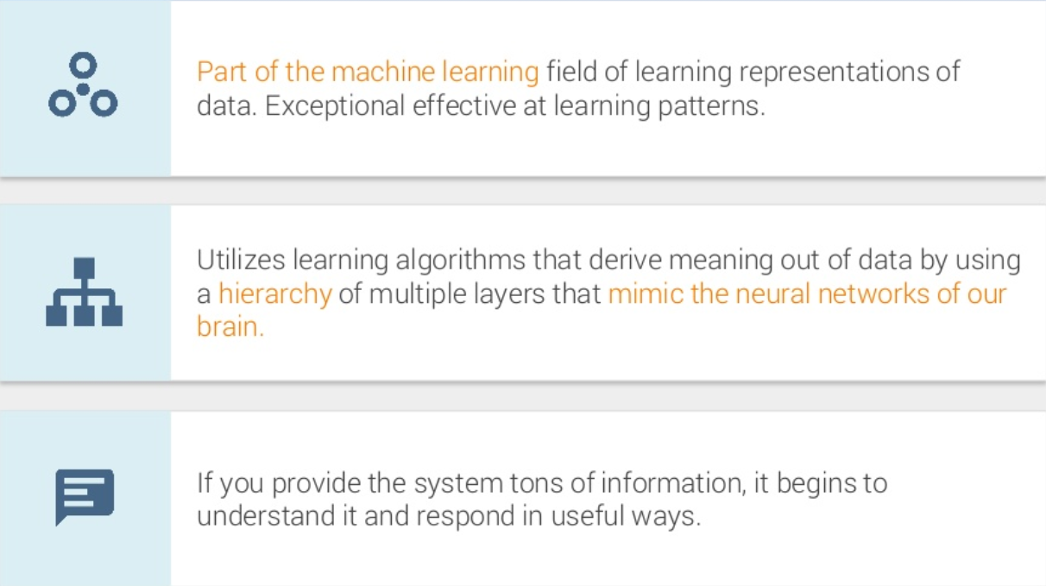
What is Deep Learning?
Notes:
https://www.slideshare.net/LuMa921/deep-learning-a-visual-introduction?qid=8f03f985-8cac-48c6-b1d9-09f77d48a9cc&v=&b=&from_search=1
Feature Extraction

Slide 7
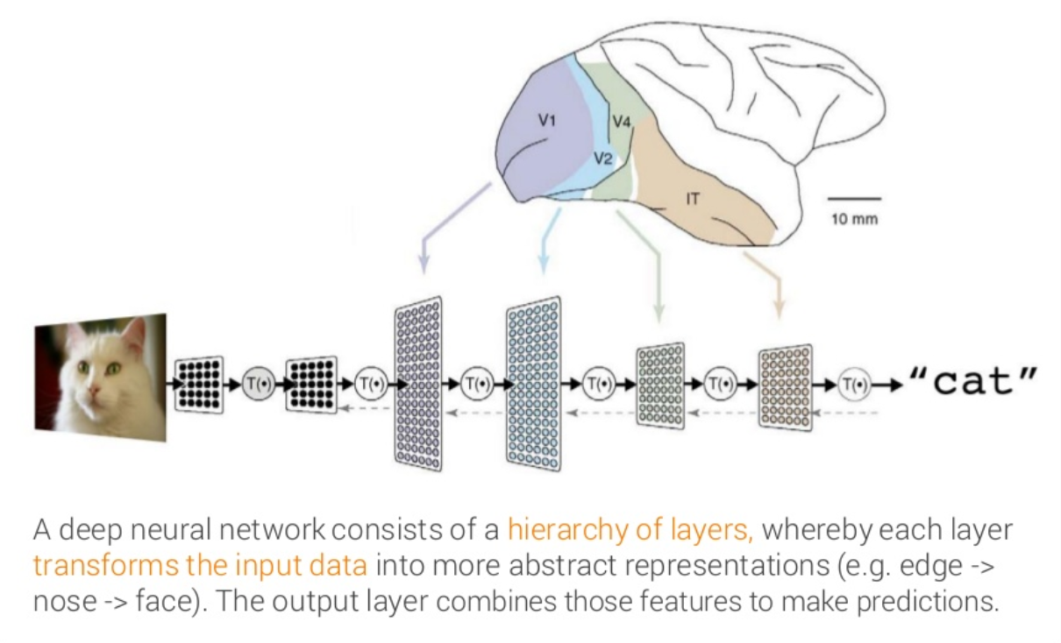
What is Deep Learning?
Notes:
https://www.slideshare.net/LuMa921/deep-learning-a-visual-introduction?qid=8f03f985-8cac-48c6-b1d9-09f77d48a9cc&v=&b=&from_search=1

Slide 8
What is a Neural Network?
Deep Learning is primarily about neural networks, where a network is an interconnected web of nodes and edges.
Neural nets were designed to perform complex tasks, such as the task of placing objects into categories based on a few attributes.
Neural nets are highly structured networks, and have three kinds of layers - an input, an output, and so called hidden layers, which refer to any layers between the input and the output layers.
Each node (also called a neuron) in the hidden and output layers has a classifier.
Notes:
https://www.slideshare.net/LuMa921/deep-learning-a-visual-introduction?qid=8f03f985-8cac-48c6-b1d9-09f77d48a9cc&v=&b=&from_search=1

Slide 9
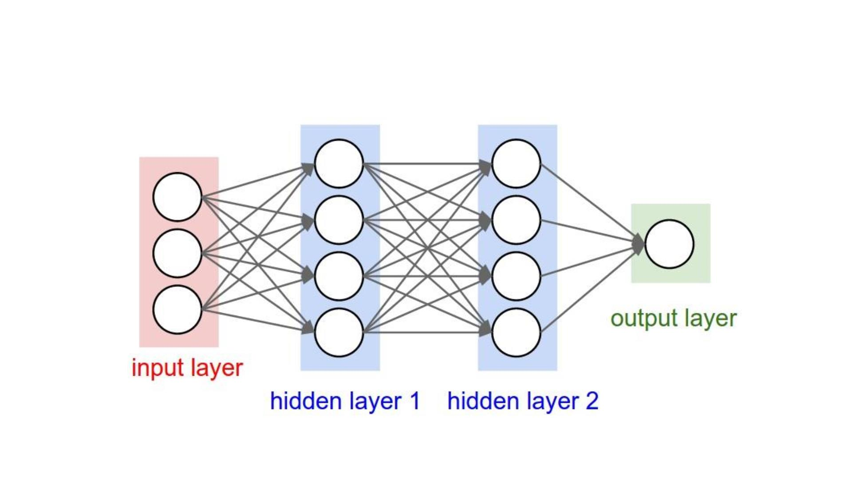
Artificial Neural Network (ANN)
Notes:
https://www.slideshare.net/LuMa921/deep-learning-a-visual-introduction?qid=8f03f985-8cac-48c6-b1d9-09f77d48a9cc&v=&b=&from_search=1

Slide 10
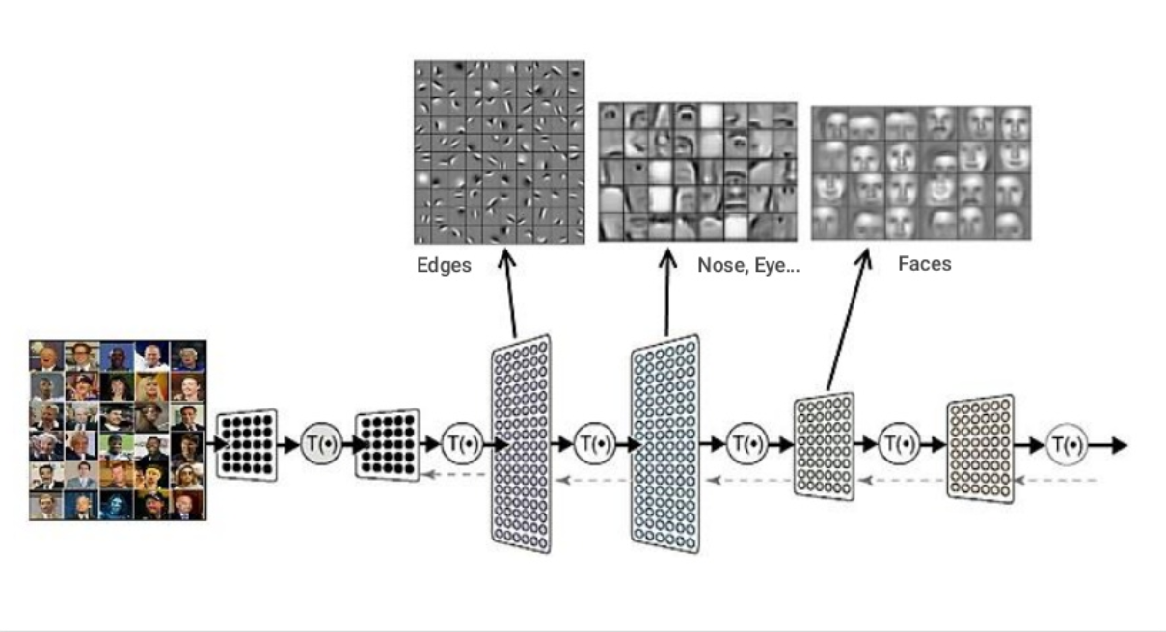
Each layer extracts higher features
Notes:
https://www.slideshare.net/LuMa921/deep-learning-a-visual-introduction?qid=8f03f985-8cac-48c6-b1d9-09f77d48a9cc&v=&b=&from_search=1

Slide 11
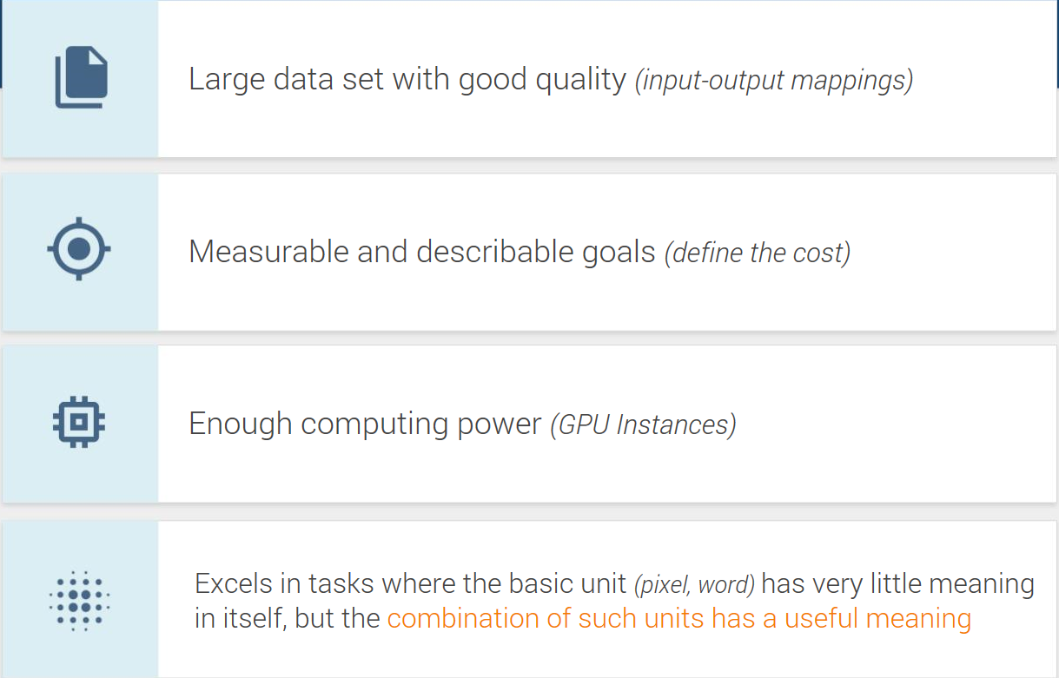
Each layer extracts higher features
Notes:
https://www.slideshare.net/LuMa921/deep-learning-a-visual-introduction?qid=8f03f985-8cac-48c6-b1d9-09f77d48a9cc&v=&b=&from_search=1

Slide 12
Hyperparameter tuning issues
Choosing a set of optimal hyperparameters for a learning algorithm
Issues
Each algorithm has its own specific set of hyperparameters
Can be difficult to know which hyperparameters are pertinent to each problem
Some hyperparameters are a range, not a limited set of choices
There may be a large number of hyperparameters for any algorithm
The combination of possible hyperparameters values can be high (or infinite)
Training/Testing each hyperparameter combination can be time (and cost) consuming
Notes:
Combination of hyper-parameters is often known as “curse of dimensionality”

Slide 13
Hyperparameter tuning methods
Grid Search (traditional – and manual)
On the positive side, embarrassingly parallel
Random Search
Bayesian optimization
Gradient-based optimization
Evolutionary optimization
Notes:
Grid search is an exhaustive search through a manually specified subset.
Random search is often good when only a few hyperparameter variables are relevant. Value distributions for those parameters can be specified.
Learning rate is probably the most important hyper-parameter. Too low, takes forever. Too high and your loss rate goes nuts. Default is usually 0.01 but don’t take this for granted.
Try using adaptive learning rates! https://towardsdatascience.com/gradient-descent-algorithms-and-adaptive-learning-rate-adjustment-methods-79c701b086be

Slide 14
Some thoughts
Deep Learning can take far longer to train, but often tests faster
i.e. Res Net can take two weeks to train
Deep Learning requires large amounts of data (and large amounts of GPUs)
Keep in mind that changing/cleaning your training/testing data may be as or more influential as tuning hyper-parameters. Consider data augmentation as well.
Deep learning excels in tasks where the basic unit (i.e. a pixel or word) has very little meaning in itself, but the combination of such units has a useful meaning.
Look for libraries which allow for training across a distributed framework
Notes:
Others to keep in mind although I do not list above because they can send you down the technical rabbit hole.
This is a good site for all sorts of optimization ideas (far more than I list here)
http://rishy.github.io/ml/2017/01/05/how-to-train-your-dnn/
1 ) Choose appropriate activation functions – instead of sigmoid, use tanh. Possibly ReLU or SoftSign as alternatives.
2 ) Keeping the number of hidden layers larger than the optimal number gives the model extra flexibility to filter out the appropriate information. @Yoshua-Bengio on Quora “You just keep on adding layers, until the test error doesn’t improve anymore.”
3 ) Weight Initialization – should be initialized with small random numbers. The web link has some formulas you can use for distribution
4 ) Learning Rates – use adaptive learning rates (Adagrad or Adam)

Slide 15
Even More Information....
Introduction to Deep Learning
Deep Learning with TensorFlow

